Slide 1
ANGULAR JS
BY
SONA COLLEGE OF TECHNOLOGY

Slide 2
LIST OF FIGURES
What is Angular?
Difference between Angular JS and Angular
Drawbacks of Angular JS
Who uses Angular?
Why Angular is So Popular?
Angular 8
Angular Architecture
Building Blocks of Angular
Type Script
Files and Folders Created while Creating a new project

Slide 3
What is Angular?
Angular is a Google-developed, open-source, cross-platform framework for creating interactive, innovative mobile applications.
It combines declarative templates, dependency injections, end-to-end resources, and built-in best practices to address the developer’s development challenges.
Single-Page Applications (or SPA’s) are applications that are accessed via a web browser like other websites but offer more dynamic interactions resembling native mobile and desktop apps

Slide 4
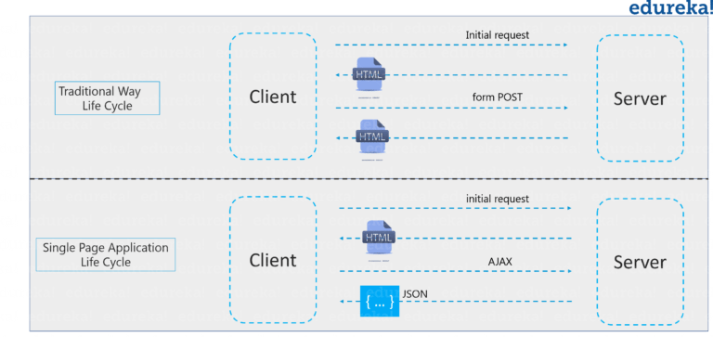

Slide 5
Difference between Angular JS and Angular
Angular JS
Angular
Uses scope and controller for variables.
Two way binding is done using ng-model.
Used third party mobile libraries as there was no native mobile support.
Dedicated directives are provided for event (ng-click) and proper binding (ng-bind).
Uses components and has no terms like scope and controllers.
Two way binding is done using [(ngModel)].
No need to use third party libraries for mobile support as angular comes with native mobile support.
Dedicated syntax are provided for event ( () ) and property binding ([]).

Slide 6
Drawbacks of Angular JS
Not Secure
Not degradable
Size of Angular Js is large
It does not support mobile devices.

Slide 7
Who uses Angular?
Angular is widely used by many companies to create their websites. Some of them are
Google
Microsoft
Samsung
VM ware
Santander

Slide 8
Why Angular is So Popular?
Easy to use
Two-way data binding
Easy to test
Data security
Compatibility

Slide 9
Angular 8
Angular is a TypeScript-based open-source front-end web application platform led by the Angular Team at Google and by a community of individuals and corporations.
Angular is a complete rewrite from the same team that built AngularJS.
Angular is completely different from AngularJS.

Slide 10
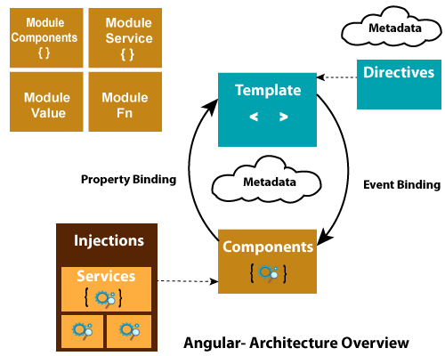
Angular Architecture

Slide 11
Building Blocks of Angular
The main building blocks of Angular are:
Modules
Components
Templates
Metadata
Data binding
Directives
Services
Dependency injection

Slide 12
Type Script
TypeScript is a typed superset of JavaScript that compiles to plain JavaScript.
TypeScript is pure object oriented with classes, interfaces and statically typed like C# or Java.
The popular JavaScript framework Angular 2.0 is written in TypeScript.
TypeScript can help programmers to write object-oriented programs and have them compiled to JavaScript, both on server side and client side.

Slide 13
Files and Folders Created while Creating a new project
Set up your environment.
Create a new workspace and initial app project.
Serve the application.
Make changes to the application.

Slide 14
Thank You!

